Slide 1

Annual Race Cars Rally
Penn Liberty Motors

Slide 2
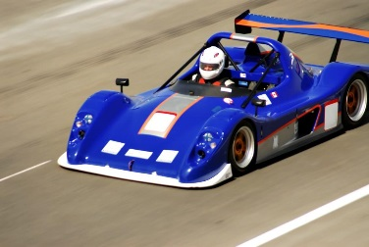
Events
Tournaments
Demonstrations
Entertainment
Sales
Auctions

Slide 3
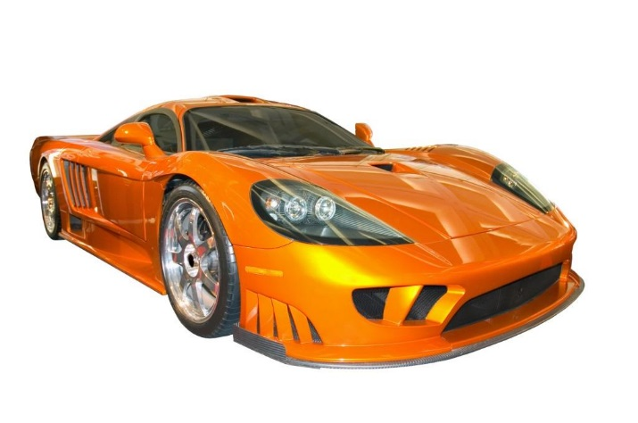
Activities
Meet Professional Race Car Drivers
Rides for Children
Race Car Workshops
Contests
Raffles

Slide 4
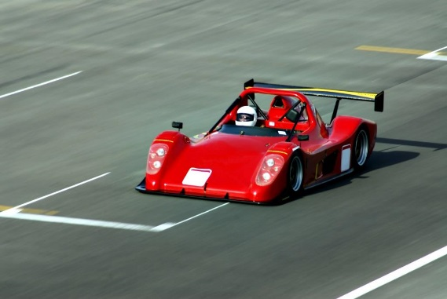
Exhibitors
Race Cars
Race Car Simulators
Transporters
Roll Cages

Slide 5

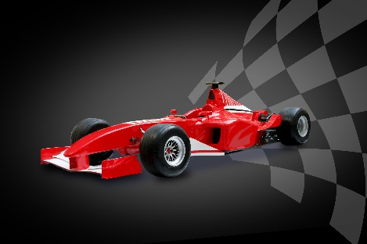
Selling Booths
Engines
Tires
Gear Boxes
Rack and Pinion Mounts
Shock Mounts
Chassis Kits

